Slide 1
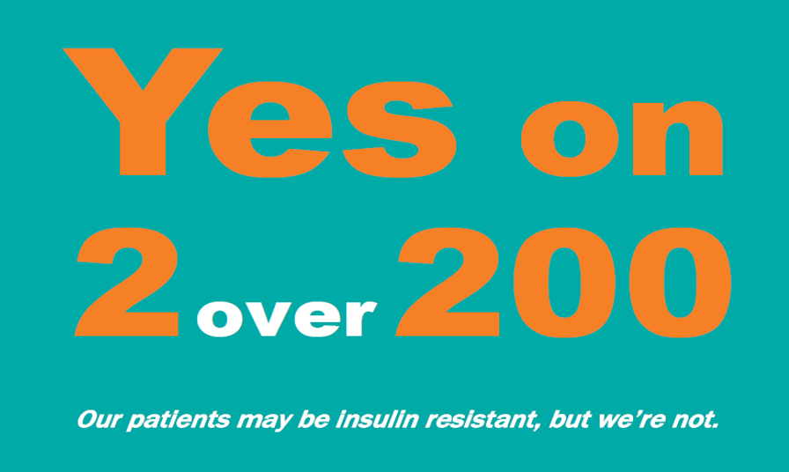
2 Over 200 Campaign
If an adult, non-pregnant patient has two blood glucoses > 200 in a 24-hour time frame, hyperglycemia needs to be addressed.
If not addressed, nursing staff notifies the provider to take action.
Our patients will feel better and heal faster!

